Slide 1
Regression Analysis
Analysis of Variance
Nicoleta Serban, Ph.D.
Professor
School of Industrial and Systems Engineering
Basics Concepts

Slide 2

About This Lesson

Slide 3


ANOVA: Analysis of Variance
Population 1: ($μ$₁, $σ_{1}^{2}$) Sample 1:(Y_{1,1},…,Y_{1,n1})
Population 2: ($μ$₂, $σ_{2}^{2}$) Sample 2: (Y_{2,1},…,Y_{2,n2})
$$\left({\overline{Y}}_{2}, s_{2}^{2}\right)$$
.......
Population k: ($μ$_{k}, $σ_{k}^{2}$) Sample k: (Y_{k,1},…,Y_{k,nk})
$$\left({\overline{Y}}_{k}, s_{k}^{2}\right)$$
ANOVA: Comparing the means of multiple samples
Notes:
I need to introduce all notation on this slide clearly: I will use the notation in the later slides

Slide 4

ANOVA Example 1: Global Suicide
Data Source:
Suicide Rate: Kaggle
https://www.kaggle.com/russellyates88/suicide-rates-overview-1985-to-2016
Notes:
Each singer in the NY Choral Society in 1979 self-reported his or her height to the nearest inch. Their voice parts in order from highest pitch to lowest pitch are Soprano, Alto, Tenor, Bass. The first two are typically sung by female voices and the last two by male voices. One can examine how height varies across voice range, or make comparisons of sopranos and altos and separate comparisons of tenors and basses.

Slide 5
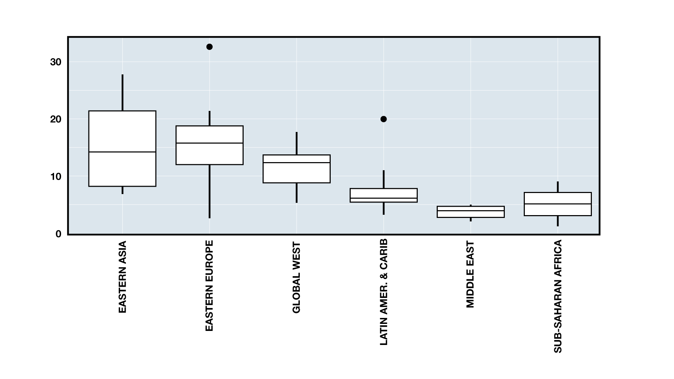
ANOVA Example 1: Suicide Rate & Region
Is there a difference in the suicide rate by region?
Which region has higher suicide rate?

Slide 6

ANOVA Example 2: Keyboard Layout
Three different keyboard layouts are being compared in terms of typing speed.
Layout 1 Layout 2 Layout 3
23.8 30.2 27.0
25.6 29.9 25.4
24.0 29.1 25.6
25.1 28.8 24.2
25.5 29.1 24.8
26.1 28.6 24.0
23.8 28.3 25.5
25.7 28.7 23.9
24.3 27.9 22.6
26.0 30.5 26.0
24.6 * 23.4
27.0 * *

Slide 7
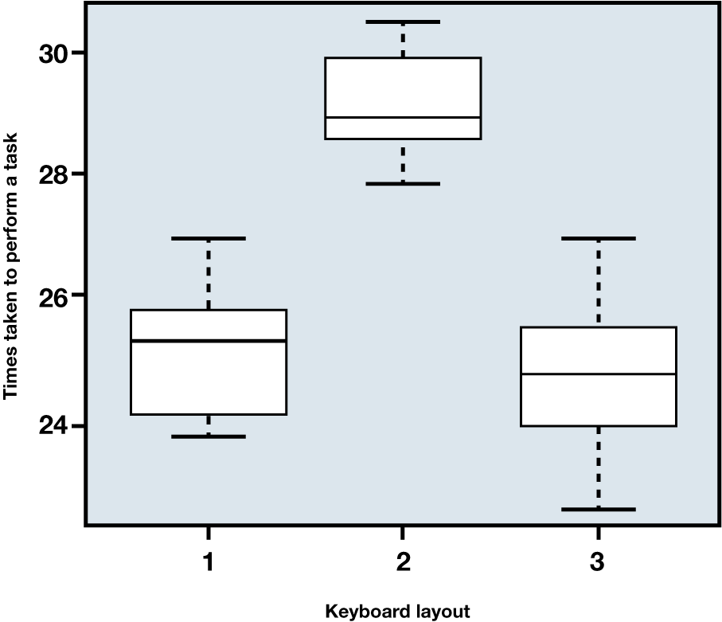
Operation Time by Keyboard Layout
Is there a difference in the time taken to perform a task?
Which layout is more effective?

Slide 8


ANOVA: Objectives
Primary objectives in ANOVA:
Analysis of the variability in the data – the ANOVA table
Testing for equal means
Estimation of simultaneous confidence intervals for the mean differences
H_{o} : $μ$₁ = $μ$₂ = … = $μ$_{k}
$μ$_{i} – $μ$_{j} for i and j =1,…,k

Slide 9

Summary

